Slide 1
Background Image

Slide 2
Agenda
Background image
Sample output
Background image implementation

Slide 3
Background image
We can set background image to the web page in various ways.
We can select image from
local images
online images
We can repeat the background image on we can have it as on image.
Syntax:
background-image: url("image name");
background-image: url("url here");

Slide 4
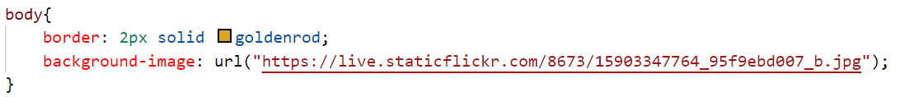
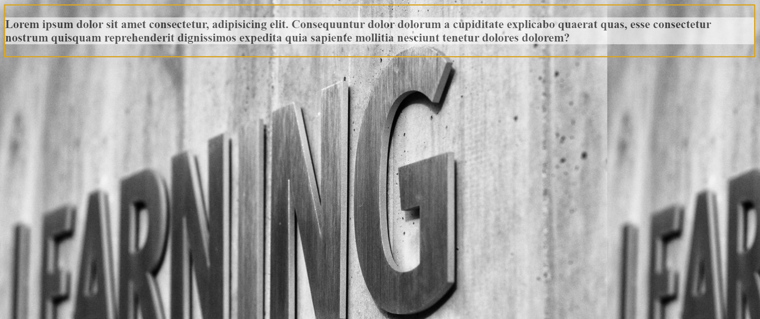
Sample output

Slide 5
Background image
We can also repeat the same image if the dimensions do not match.
We can also resize the image, repeat only in specific direction also with the help of various properties. The properties and values are,
background-size: 100%;
background-repeat: repeat-x;
background-repeat: repeat-y;
background-repeat: no-repeat;
background-repeat: repeat;
We will see the implementation of these in this video.

Slide 6
Background image implementation
Lets see the example of the background image and its styling

Slide 7
Summary
We can set background image using HTML or CSS property.
In CSS we can repeat the background image so that it will cover the entire space if the dimensions are different. We also have the feasibility to control it.
DO NOT WRITE ANYTHING
HERE. LEAVE THIS SPACE FOR
WEBCAM

Slide 8
Thank You
Proprietary content. ©Great Learning. All Rights Reserved. Unauthorized use or distribution prohibited

